Slide 1
Study Abroad Information Session
School of Social Sciences and Philosophy and Trinity Business School
Dr Matthias Dilling
Director of Study Abroad
October 03, 2025

Slide 2
Study abroad opportunities at Trinity
College-wide exchanges (also called international exchanges)
Study Abroad at Trinity’s partner universities outside Europe
Applications managed by Trinity Global & open to students in many Schools/Departments
You can apply for a Global Mobility Bursary
More details here
Departmental exchanges (generally Erasmus+)
Erasmus+ is the EU’s programme to support e.g. education within Europe
Note: Some Schools/Departments also have Non-EU exchange partners
Applications managed by Trinity Schools/Departments
You can apply for an Erasmus+ Grant
More details here & list under your subject(s)

Slide 3
Application window
Applications open on 06 October 2025
Applications close on 14 November 2025
You have the full application window to apply. We strongly encourage you to apply within that window once you have done your research and decided on your preferences.
There are limited places for each university. We cannot guarantee a place or a specific preference.

Slide 4
Departmental exchanges (mostly Erasmus): Destinations
Depending on availability and eligibility (!)
Economics
Australia: Queensland University of Technology
Belgium: KU Leuven (currently renewed)
France: Sciences Po Paris
France: HEC Paris (currently renewed)
Germany: Universität zu Köln
Netherlands: Tilburg University
Spain: Esade Ramon Llull University
Sweden: Stockholm School of Economics
Philosophy
Austria: Central European University
Belgium: KU Leuven
Germany: Humboldt University Berlin
Germany: LMU Munich
Turkey: Koç University

Slide 5
Departmental exchanges (mostly Erasmus): Destinations
Depending on availability and eligibility (!)
Political Science
Austria: Central European University
France: Sciences Po
Germany: Universität Mannheim
Italy: Università di Bologna
Italy: Università Bocconi
Spain: Universitat Pompeu Fabra Barcelona
Switzerland: University of Zurich
Sociology
Czechia: Charles University
Denmark: University of Copenhagen
Finland: University of Helsinki
Germany: LMU Munich
Malta: University of Malta
Netherlands: Utrecht University
Spain: Universitat de Barcelona
Sweden: Umeå University
Turkey: Boğaziçi University

Slide 6
Departmental exchanges (mostly Erasmus): Destinations
Depending on availability and eligibility (!)
Business
Very long list of destinations (please see website: https://www.tcd.ie/ssp/undergraduate/study-abroad/outgoing/destinations/).

Slide 7
Which Departmental exchanges can I go on?
  Check the exchanges available for each department you are studying with as well as any associated eligibility information on the website: https://www.tcd.ie/ssp/undergraduate/study-abroad/outgoing/destinations/
  You are eligible to apply in either Department/School you are studying with
    There are some international (non-EU) exchanges offered by Trinity Business School and the department of Economics
  It is your responsibility to select exchanges that are suitable for your subject combination before you list them on the application form.

Slide 8
Things to consider before applying
Opportunity and challenge
  Erasmus is a wonderful opportunity:
    ‘An absolute must. best decision I ever made & I wasn’t even too excited about it when I went. Tell students … it's worth it! Doesn’t matter where you go either, it’s just about the friends you make.’
    ‘By far the best year of my life overall.’
  BUT part of the experience can be challenging:
    ‘I hadn't fully considered the implications of moving away from family and friends for 7 months and at times found this harder than I had expected. However overall it was a great experience and I would definitely do it again.’
  Part of the experience is taking responsibility, being comfortable in a new and different environment, developing resilience and independence.

Slide 9
Things to consider before applying
Half a year or a full year?
  If you spend half a year abroad, you will be examined on the basis of work completed in Trinity and abroad
  If your second subject is not offered in a university you are interested in, you may consider going on a half year exchange, provided you are able to frontload your modules - check with coordinator
  There is a section to indicate your preference on the application form
  It is School policy (SSP and TBS) that you CANNOT go to two different destinations in one academic year.

Slide 10
Departmental exchanges: Timeline
Applying
Offer and personal declaration
Preparing to go away
Requirements while away
Results, progression, and return

Slide 11
Departmental exchanges: Timeline
1) Applying
Applications open on 06 October 2025
Applications close on 14 November 2025
Application form will be available on: http://www.tcd.ie/ssp/undergraduate/study-abroad/Apply/
Clicking on the link for the form will prompt you to log in using your Trinity SSP and then open a Microsoft Forms. Only fully completed applications submitted via that Microsoft Form will be accepted.
You will be asked to list up to five top preferences.
Please do your homework on which exchanges are suitable for your subject combination before you list them on the form.
Places will be allocated on basis of grades, availability and suitability of exchanges.

Slide 12
Application: Criteria and requirements
  Grades
  Grades received in Junior Freshman year (please enter NUMERICAL grade)
  College requirement is that students must have a minimum grade of 2.2
  Some Schools/Departments may require 2.1
  Language proficiency
  Typically a B2 in the language of instruction is required
  Erasmus+ Language support & placement test available through EU ‘Online Linguistics Support’

Slide 13
Departmental exchanges: Timeline
2) Offer and personal declaration
  First round offers will be made in mid- to late-January
  Those who have accepted a College-wide exchange offer will not be offered an Erasmus place. It is our School policy that you cannot go to two different destinations in one academic year.
  You must accept the offer within the time specified in the offer email.
    Before you accept, please check that the offer meets your degree requirements and consider financial implications etc. Withdrawals are only permitted in exceptional circumstances.
    The offer will come with a link to the Personal Declaration form, which must be completed. Acceptance decisions submitted without a completed Personal Declaration form will not valid.
    If you reject or do not reply to an offer, you will be excluded from the selection process.
  Remaining places will be offered in following rounds.

Slide 14
Departmental exchanges: Timeline
2) Offer and personal declaration (con.)
  You will be invited to apply to the host university after TCD has nominated you
    This process differs slightly in each host university
    Ensure to do this promptly when invited (may be later for Hilary Term exchanges)
  Offers are made subject to conditions and an absolute minimum of a Second Class Honour (II.2) in the Senior Fresh year is required for all Erasmus exchanges.
    Start planning early but make commitments at your own risk until you are registered with host & sure to pass your 2nd (SF) year with at least a Second Class Honour (2.2).
    TCD supplementals in late August: if you cannot proceed to 3rd year, you cannot go on exchange.

Slide 15
Departmental exchanges: Timeline
3) Preparing to go away: Check potential additional support
Erasmus+ Grant for Study
    Typically €300 to €450 per month, but funding may vary and is not guaranteed
    Not affecting SUSI grants and the NI Student Loan, but check with the Academic Registry Financial Aid Officer about other grants/loans.
    To apply, send the following things to erasmus.outgoing@tcd.ie
    Erasmus+ grant agreement (signed by you)
    Learning agreement
    Confirmation of arrival/departure (for second payment)
  Extra financial support may be available to students with a disability who may require specific services while abroad

Slide 16
Departmental exchanges: Timeline
3) Preparing to go away: Complete required paperwork
E.g. pre-approved module form/PAM, insurance, Erasmus Learning Agreement/LA, etc.
  Checklist and templates can be found via the SSP website. All forms submitted via MS Forms (via SSP website), NOT BY EMAIL!
  PAM: list modules you like to take and some back-up modules in case you cannot do your preferred ones. Modules will be approved by subject coordinators. Timing varies by host institution (at or after registration, before or soon after arrival).
  LA: include only approved modules; so extra modules on the PAM are advised. The LA may be changed subject to approval.

Slide 17
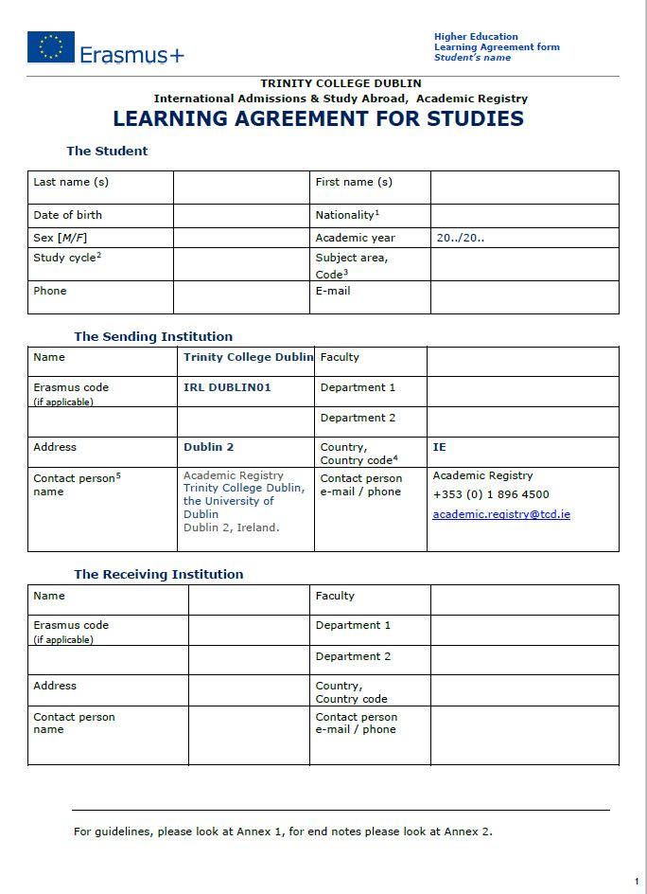
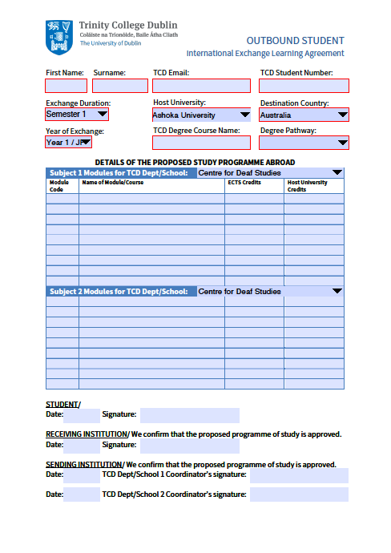
The Learning Agreement
This is a very important document
  You must complete the Learning agreement
  Have it signed by your TCD coordinator(s)
  Have it signed and stamped by your host University
  May be completed online depending on host
  All changes to the learning agreement must be approved by your TCD coordinators.

Slide 18

The Learning Agreement
If a student deviates from the programme of study agreed upon in their learning agreement, coordinators are not obliged to accept non-approved modules, which could jeopardize the student’s ability to progress.

Slide 19
Departmental exchanges: Timeline
3) Preparing to go away: Other steps
Attend offer holder and pre-departure meeting
Prepare departure (find accommodation, etc.)
You must remain registered at TCD even if you go abroad for a full year, so make sure you are registered before leaving.
Make sure you have a valid passport and the European Health Insurance Card (EHIC).
Non-EU students - check visa requirements. Host will advise. Consult relevant Embassy here. May need to deal with Embassy in your home country if there for the summer.

Slide 20
Departmental exchanges: Timeline
4) Requirements while away
Full Year Exchanges
  Students must enrol in modules equivalent to 60 ECTS
    The results will be calculated on the best relevant 45 ECTS
  ------------------------------------------------------------------------------------------------
One Term Exchanges
  Students must enrol in modules equivalent to 30 ECTS
    The result will be calculated on the best relevant 20 ECTS
  For the term spent in TCD, students take 30 ECTS.
  Ensure that you cover any prerequisites for your intended SS modules/capstone.

Slide 21
Departmental exchanges: Timeline
4) Requirements while away
All documents needed for your exchange are provided by Erasmus/International exchange offices or available on the School website: https://www.tcd.ie/ssp/undergraduate/study-abroad/outgoing/
On Academic issues, stay in touch with your coordinator(s) via their exchange email address:
    Especially important if you fail modules that jeapordize your ability to get requisite ECTS.
For pastoral issues, stay in touch with your college tutor
    It is recommended that you contact your tutor before you leave for Erasmus to let them know that you will be going away.
For queries about the Erasmus grant contact Erasmus.Outgoing@tcd.ie
For other queries, contact your Programme Administrator

Slide 22
Departmental exchanges: Timeline
4) Requirements while away
  We expect you to:
    Research exchange programmes thoroughly before you apply/accept an offer
    Be able to act independently on a day-to-day basis
    Investigate courses in advance, but expect to be flexible
    Inform us if you encounter difficulties
  Although we will give you all assistance that we can to support you academically, we cannot:
    Help with finding accommodation
    Control the courses that other universities offer
    Review or intervene in the decisions of partner universities

Slide 23
Departmental exchanges: Timeline
5) Results, progression, and return
Please ensure your official transcript is sent to your main coordinator as soon as the official transcript from the host university becomes available.
Your grades will be translated using the School conversion tables (see SSP website).
If you fail to meet requirements, either by failing to get the requisite number of ECTS or by taking modules not deemed appropriate, your exchange will not be validated and you will have to repeat the year.
If one semester exchange – you may have to front/back load modules during the TCD semester. OME does not allow this – will be done manually.
Register as normal with TCD for 3rd year.
  You will still pay TCD fees (not host fees) and receive any grants/scholarships as normal. SUSI Top-up available.
  TAP students should contact TAP office about other supports.

Slide 24
Coordinators and important points of contact
Business – Isilay Talay
  business.exchange@tcd.ie
  Economics – Michael Wycherley
      Econ.Exchange@tcd.ie
  Philosophy – William Ratoff
  ratoffw@tcd.ie
  Political Science – Emanuel Coman
  PoliticalScienceExchange@tcd.ie
  Sociology – Larissa Meier
  MEIERL@tcd.ie
  SSP Study Abroad (Michael Enearu)
  sspsabr@tcd.ie
  Erasmus Team at Trinity
    Erasmus.Outgoing@tcd.ie
  Trinity Global
    global.mobility@tcd.ie (also on Instagram)

Slide 25
Additional information
  Departmental Sessions:
    Economics: Monday, 06 October, 3pm, Zoom
    Philosophy: [TBC]
    Political Science: [TBC]
    Sociology: Monday, 06 October, 4pm, Zoom
    Business School: [TBC]
  See www.tcd.ie/ssp/undergraduate/study-abroad/outgoing/
Please see also the Handbook for Outgoing Students.

Slide 26
Thank You!

