Slide 1
Study Abroad Information Session School of Social Sciences and Philosophy and Trinity Business School
Dr Yekaterina Chzhen
Director of Study Abroad
April 4, 2025

Slide 2
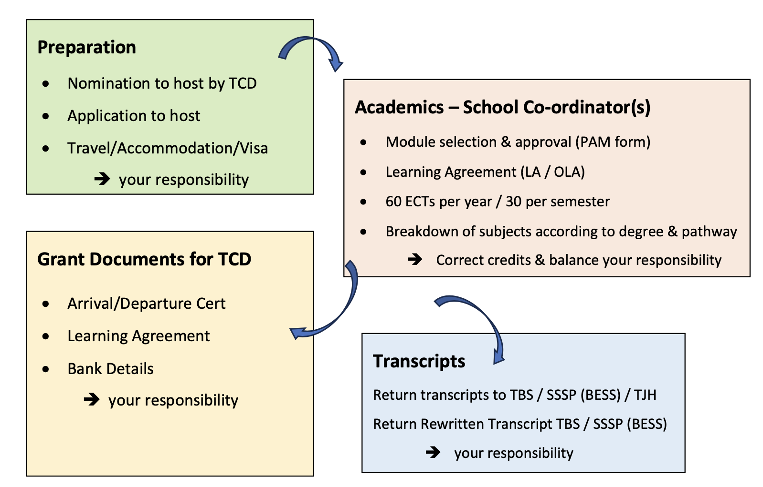
Summary

Slide 3
Preparing to go away
TCD Global sends your name to the host institution.
From March onwards. Ongoing now.
Host institution invites you to apply/register.
Dates vary! Don’t miss deadlines! Act quickly!
Travel and accommodation – your responsibility.
Start planning early but make commitments at your own risk until you are registered with host & sure to pass your 2nd (SF) year with at least a second class honour (2.2).
TCD supplementals in late August: if you cannot proceed to 3rd year, you cannot go on exchange.
Non-EU students - check visa requirements. Host will advise. Consult relevant Embassy here. May need to deal with Embassy in your home country if there for the summer.

Slide 4
Academic checklist
https://www.tcd.ie/ssp/undergraduate/study-abroad/outgoing/
Pre-Approved Modules Form (PAM)
List modules you would like to take as well as some back-up modules in case you cannot do your preferred ones. Modules will be approved by coordinators for each subject. Timing varies by host institution (at or after registration, before or soon after arrival).
Download template from SSP Study Abroad website.
Learning Agreement
Only approved modules should be included in the LA so extra modules on the PAM are advised. The LA may be changed if a course is not what you expected.
May be on-line (OLA) if host also uses the on-line portal or via SSP Form.
All forms submitted via MS Forms (via SSP website), NOT BY EMAIL!

Slide 5
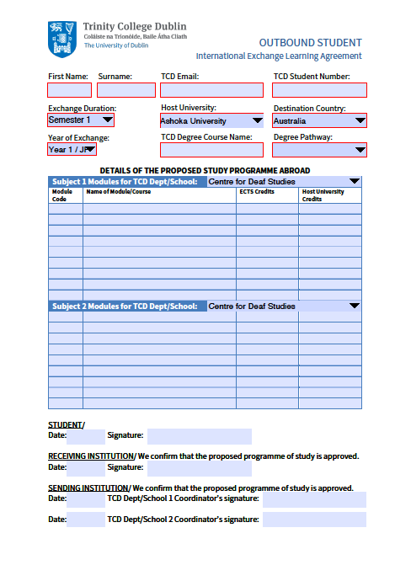
The Learning Agreement
This is a very important document
You must complete the Learning agreement
Have it signed by your TCD coordinator(s)
Have it signed and stamped by your host University
All changes to the learning agreement must be approved by your TCD coordinators

Slide 6
The Learning Agreement
If students deviate from the programme of study agreed upon in their learning agreement, coordinators are not obliged to accept non-approved modules, which could jeopardize the student’s ability to progress.

Slide 7
Applying for an Erasmus+ mobility grant
https://www.tcd.ie/study/study-abroad/outbound/apply/apply-erasmus.php
From €300 to €450 per month.
Not affecting SUSI grants and the NI Student Loan, but check with the Academic Registry Financial Aid Officer about other grants/loans.
Two instalments (80% and 20%).
To apply:
Send the following things to erasmus.outgoing@tcd.ie
Erasmus+ grant agreement (signed by you)
Learning agreement
Confirmation of arrival/departure (for second payment)

Slide 8
Requirements While Away
Full Year Exchanges
Students must enrol in modules equivalent to 60 ECTS
The results will be calculated on the best relevant 45 ECTS
------------------------------------------------------------------------------------------------
One Term Exchanges
Students must enrol in modules equivalent to 30 ECTS
The result will be calculated on the best relevant 20 ECTS
For the term spent in TCD students take 30 ECTS.
Ensure that you cover any prerequisites for your intended SS modules/capstone.

Slide 9
Requirements While Away
Please ensure your official transcript is sent to your main coordinator as soon as the official transcript from the host university becomes available.
Your grades will be translated using the School conversion tables (see SSP website).
If you fail to meet requirements, either by failing to get the requisite number of ECTS or by taking modules not deemed appropriate, your exchange will not be validated and your will have to repeat the year.
If one semester exchange – you may have to front/back load modules during the TCD semester. OME does not allow this – will be done manually.
Register as normal with TCD for 3rd year.
You will still pay TCD fees (not host fees) and receive any grants/scholarships as normal. SUSI Top-up available.
TAP students should contact TAP office about other supports.

Slide 10
Support While Away
All documents needed for your exchange are provided by Erasmus/International exchange offices or available on the School website: https://www.tcd.ie/ssp/undergraduate/study-abroad/outgoing/
On Academic issues, stay in touch with your coordinator(s) via their exchange email address:
Especially important if you fail modules that jeapordize your ability to get requisite ECTS.
For pastoral issues, stay in touch with your college tutor
It is recommended that you contact your tutor before you leave for Erasmus to let them know that you will be going away.
For queries about the Erasmus grant contact Erasmus.Outgoing@tcd.ie
For other queries, contact your Programme Administrator

Slide 11
Coordinators and Executive officers
Business – Déirdre Crowe
Email: business.exchange@tcd.ie
Economics – Michael Wycherley
Email: Econ.Exchange@tcd.ie
Political Science – Emanuel Coman
Email: PoliticalScienceExchange@tcd.ie
Philosophy – John Divers
Email: diversj@tcd.ie
Sociology – Annatina Aerne
Email: aernea@tcd.ie
SSP Study Abroad (Michael Enearu)
Email: sspsabr@tcd.ie

Slide 12
Thank You Remember, we are here to support you whilst on exchange – STAY IN TOUCH!

