Slide 1
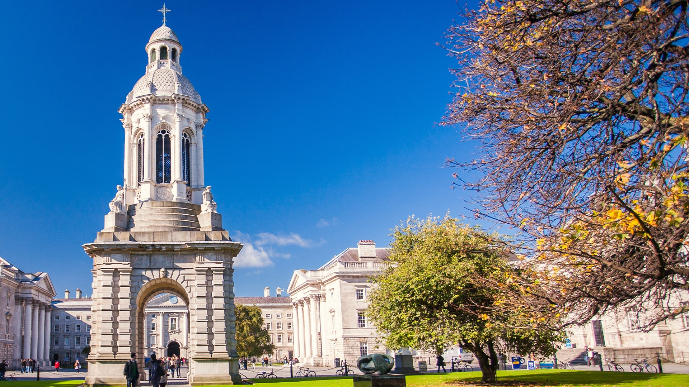
Sustainability in Trinity
How you can play your part.
Jane Hackett,
Sustainability Manager
Trinity Sustainability

Slide 2
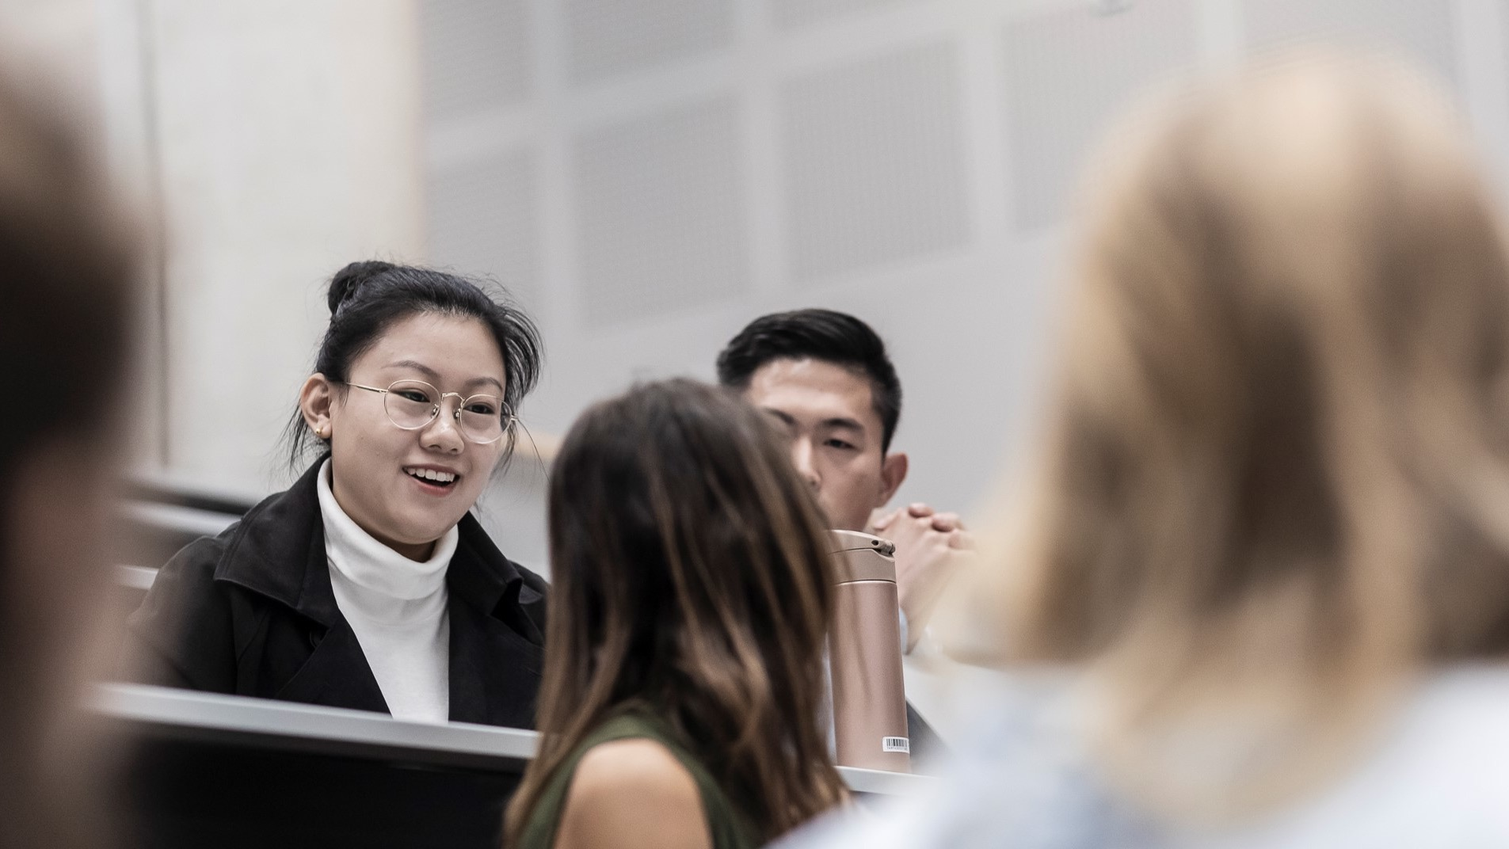
What is Trinity doing?
Trinity College Dublin, The University of Dublin

Slide 3
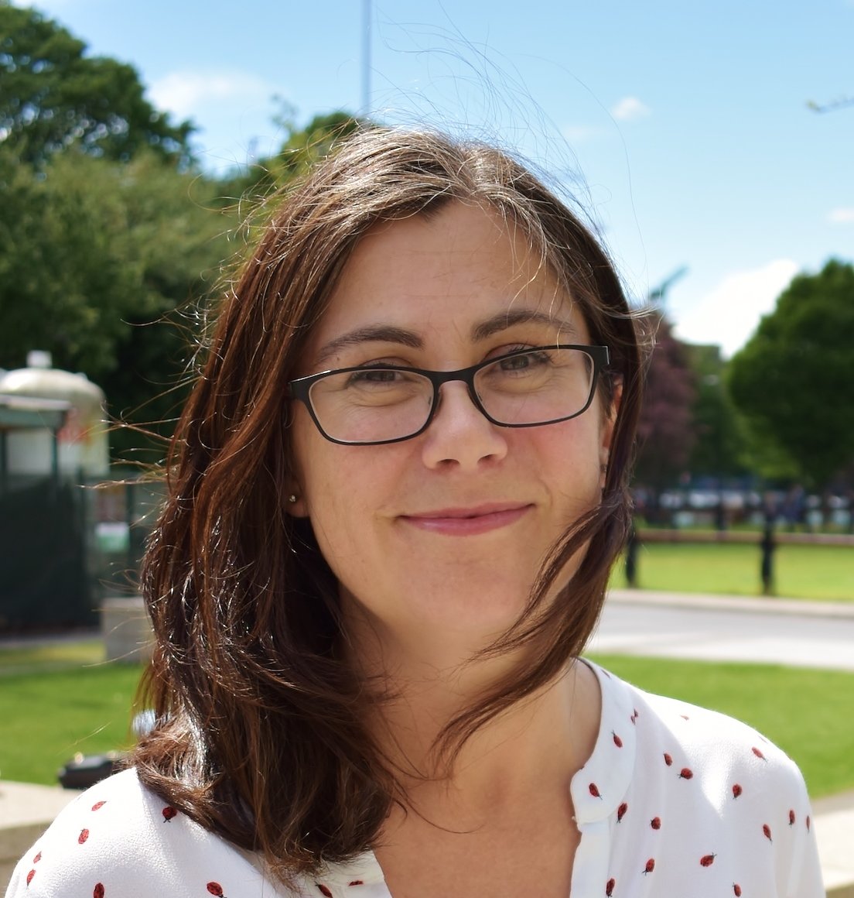
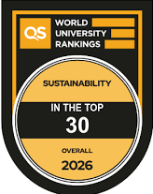
‘Healthy Planet, Healthy People’
Trinity Sustainability led by:
Prof. Jane Stout,
Vice President for Biodiversity and Climate Action

Slide 4
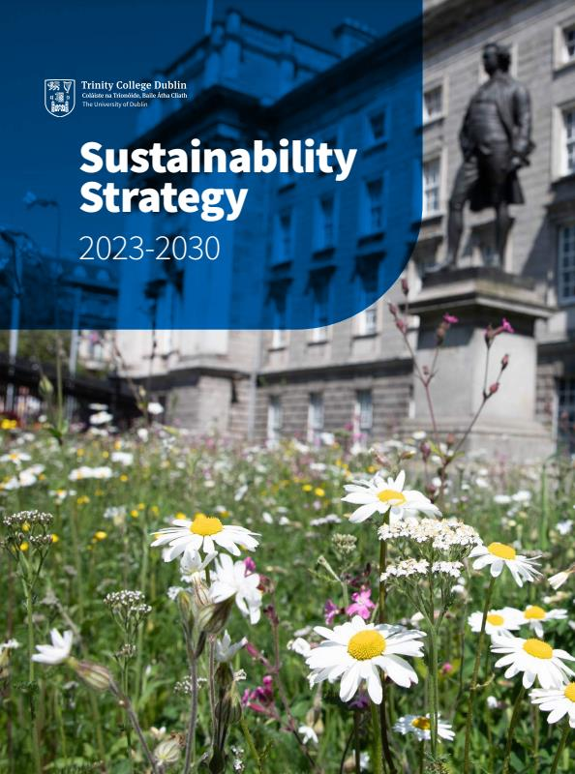
Vision - We will be a university, a place, and a community where climate change and biodiversity loss are addressed in a holistic, integrated and health-focussed way to protect and restore our planetary home for future generations.
Mission - To tackle climate and biodiversity challenges for a healthy planet and healthy people through our educational programmes, our research and innovation, and our day-to-day operations, both within Trinity and in partnership with external collaborators and communities.
www.tcd.ie/sustainability

Slide 5
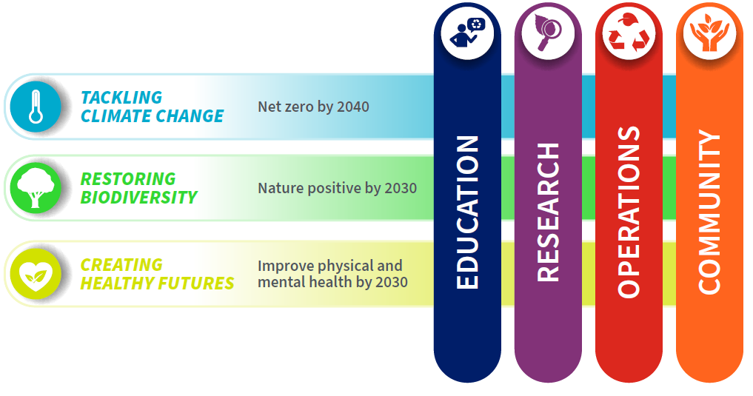

Notes:
to looking across everythiBecoming Nature Positive
Nature Positive means halting and reversing nature loss so that species and ecosystems start to recover.
For a university, we consider that being Nature Positive means restoring species and ecosystems that have been harmed by the impacts of a university and its activities and enhancing the university’s positive impacts on nature.
This refers to everything a university does, from its teaching and research work to the operations and supply chains that keep it running.
ng we do
And we identified three headline targets to be delivered across four areas.
These four areas are the same as those recently identified in the European University Association roadmap
Challenge 3 – how do we do this?
Broke each into specific objectives, actions and identified responsible bodies for those actions

Slide 6

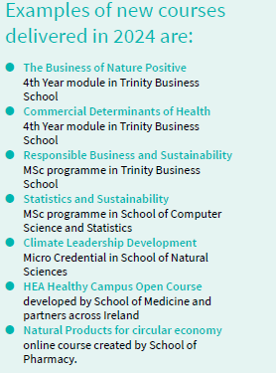
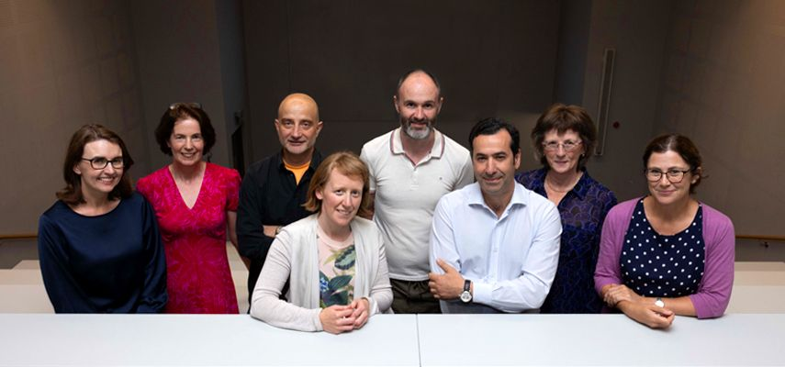
Education for Sustainable Development team
Notes:
Education for Sustainable Development
Auditing the UG and PG curriculum
Developing new module(s)
Embedding in existing modules
Training staff

Slide 7
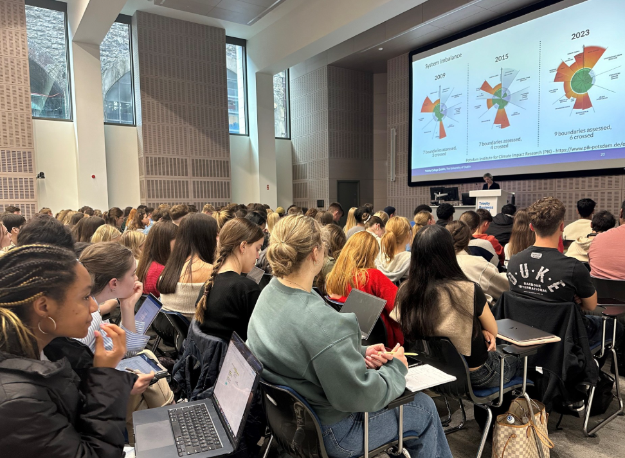
Embedding Sustainability in our Curriculum
New Sustainability Module entitled:
Enacting Sustainable Development
1200 new students from Trinity Business School took the module in Sept. 2024 & 2025

Slide 8
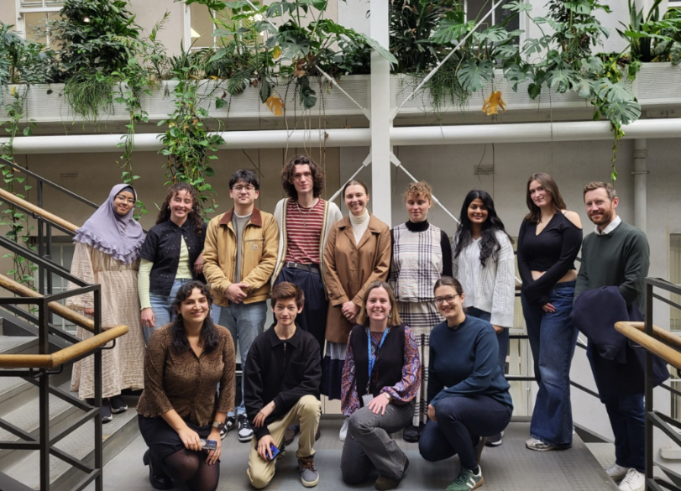

Students Organising for Sustainability SOS –
Audit of the curriculum and whole of university

Slide 9

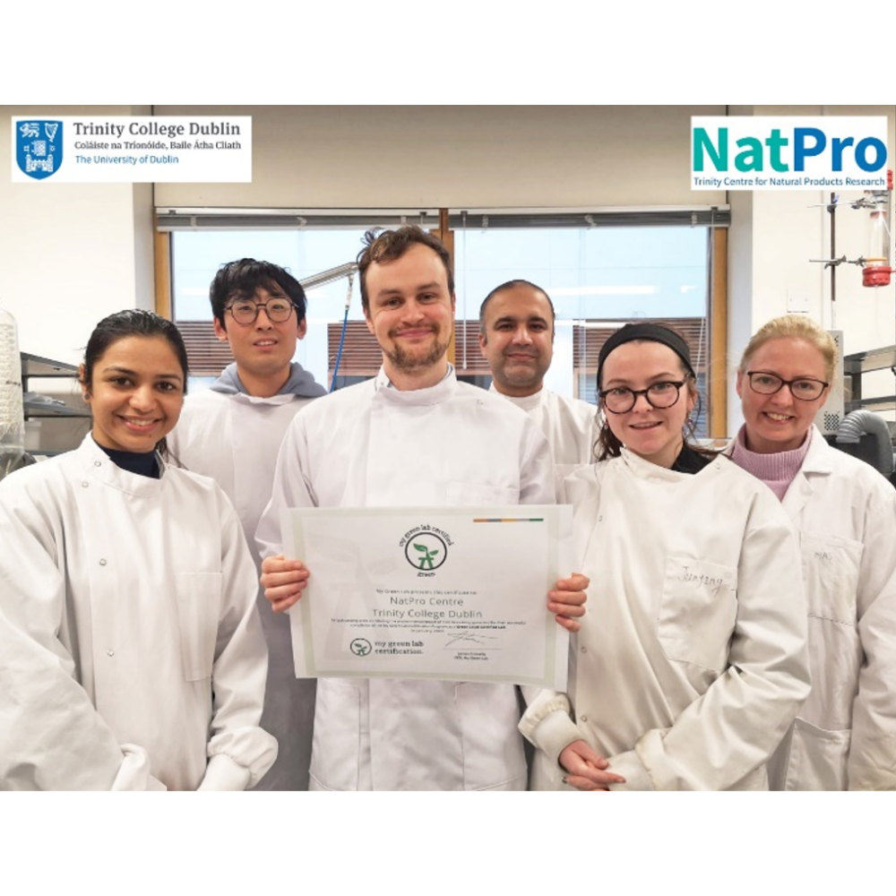
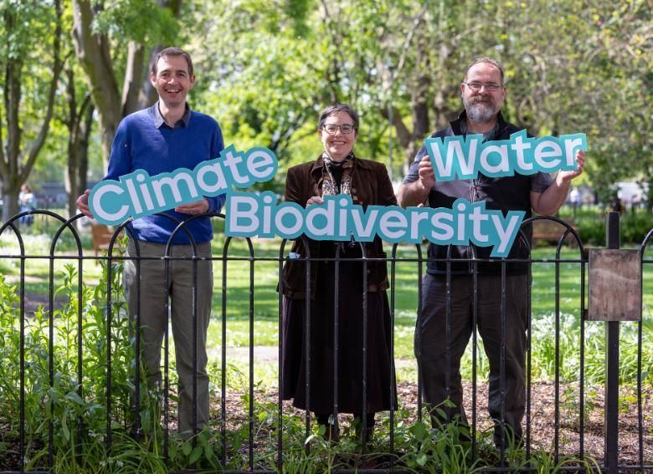
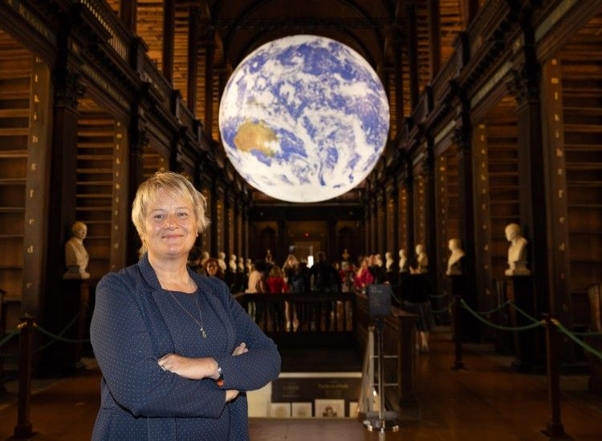
Launched - Co-centre for Climate+ Biodiversity and Water
Climate Gateway
Chair of Climate Science, Prof. Karen Wiltshire
Green Labs
450 labs in Trinity
120+ going through accreditation with My Green Lab

Slide 10

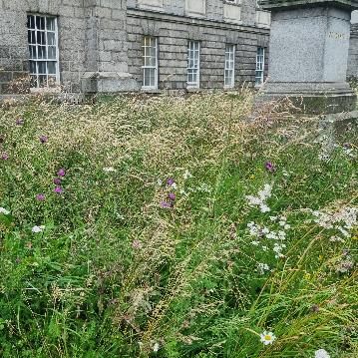
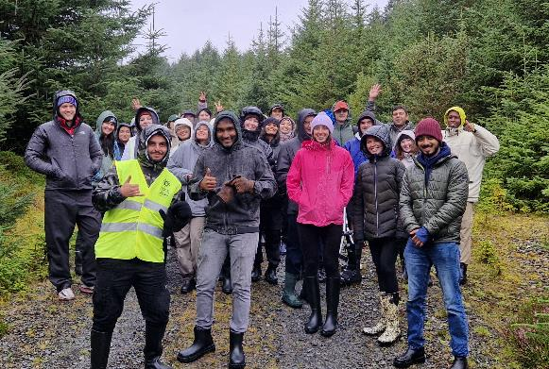
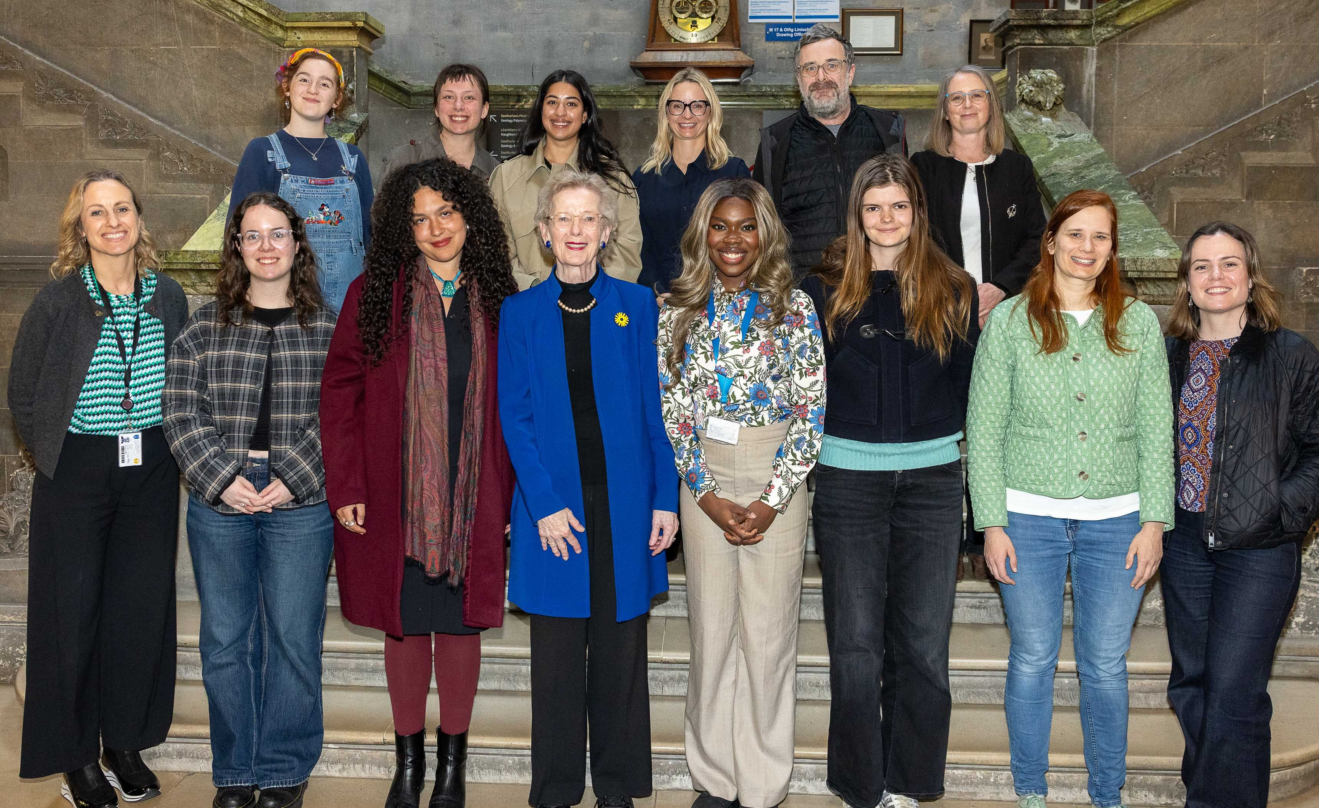
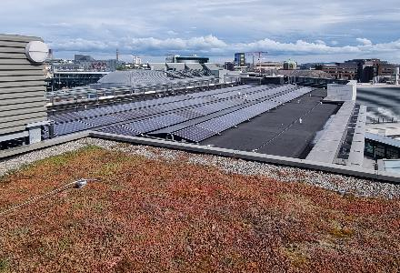

Nature Positive Campus
Climate Smart Campus
Active Campus
Circular Campus
Responsible Campus
Notes:
Our sustainability strategy is broader than just climate action
And the climate action mandate is focussed on operational and engagement actions, not education and research.

Slide 11
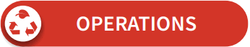




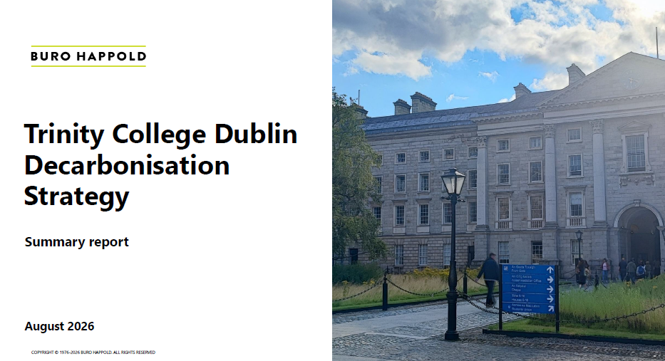
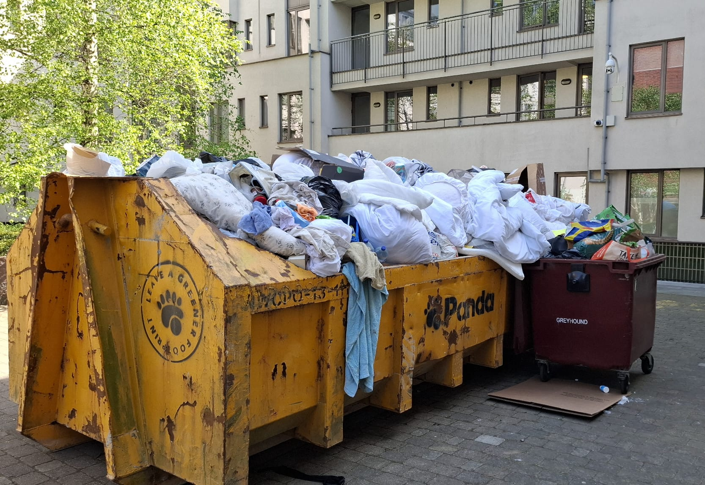
Strategic Objective: To collaborate in multi-, inter- and trans-disciplinary teams to enable our campus and day-today operations to be environmentally sustainable, with reduced carbon emissions from our infrastructure and activities, increased space for nature on site, reduced impact on nature off site, and long-term operational plans for a healthier, more resilient future.

Slide 12
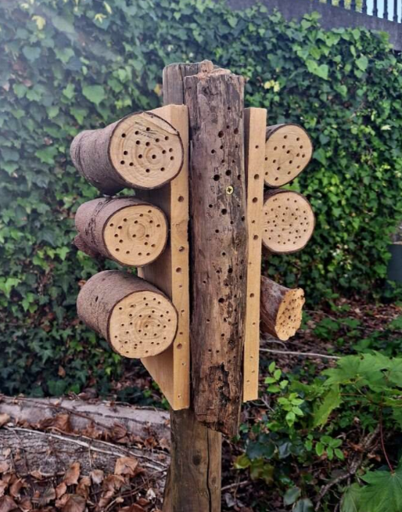
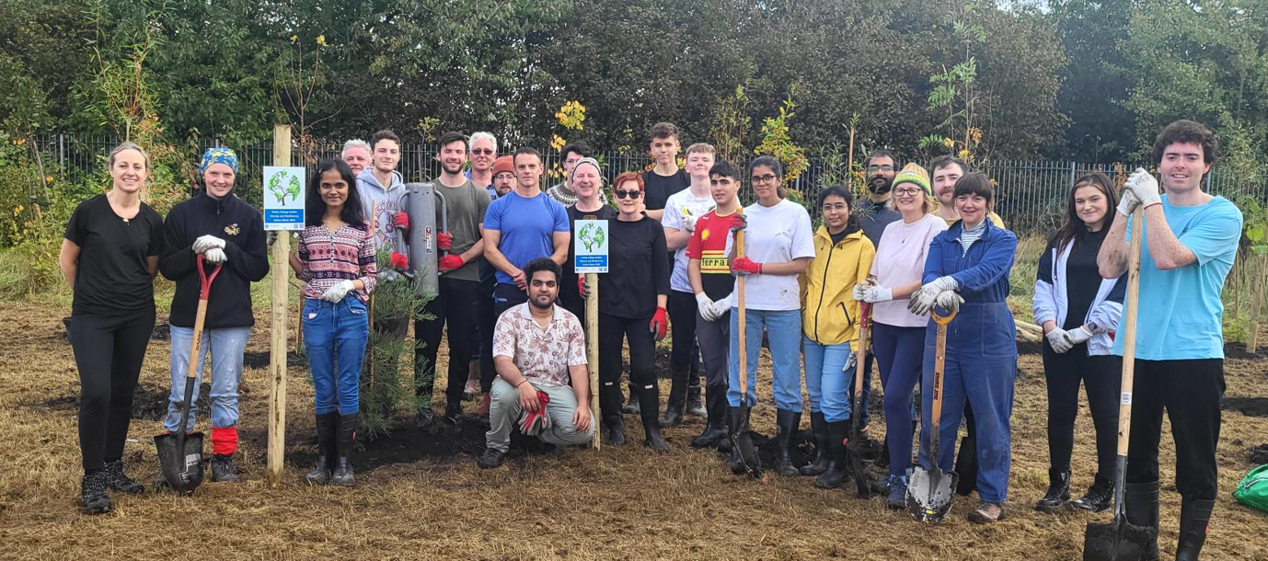
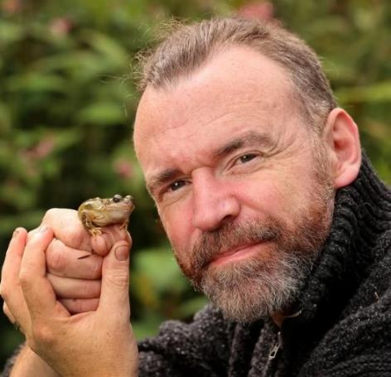
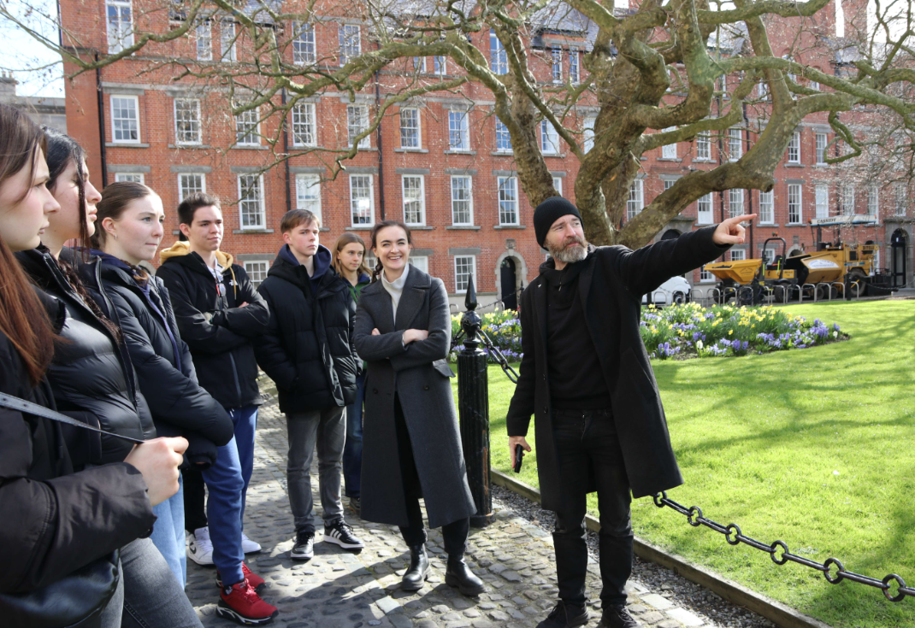
Nature positive campus
Biodiversity Officer
Annual Tree Planting Event Wednesday 14th October 2026 TBC
Collie Ennis
Notes:
So in terms of our campus operations
Firstly, nature positive campus
We have a dedicated Biodiversity Officer – well known to many - Collie Ennis started in this role in March this year
Earlier this year created a working group to develop a biodiversity plan which will be launched in next couple of weeks
Contains 3 objectives -
OBJ 1 – addresses on-site biodiversity - as already mentioned target 30% of Trinity's land is to be protected, managed, or restored for nature by 2030, prioritizing habitat quality.
That’s actually the easy bit –
OBJ 2 – operations and value chain – more challenging.
OBJ 3 – where we can have most positive impact – enhancing knowledge and partnership – still lots of work to do here too…

Slide 13
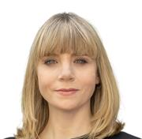

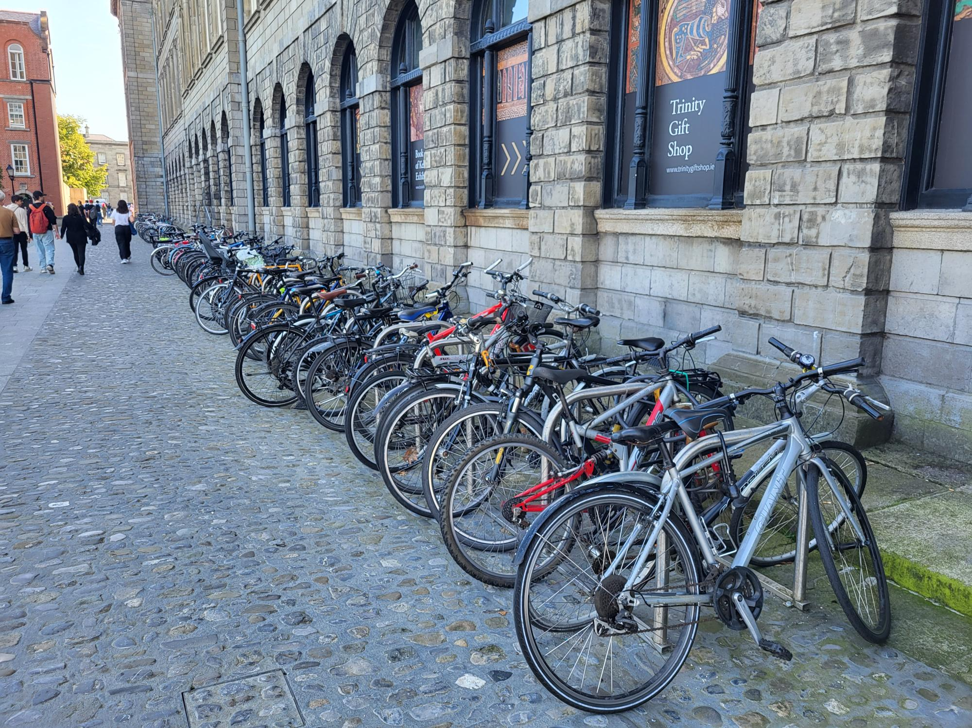
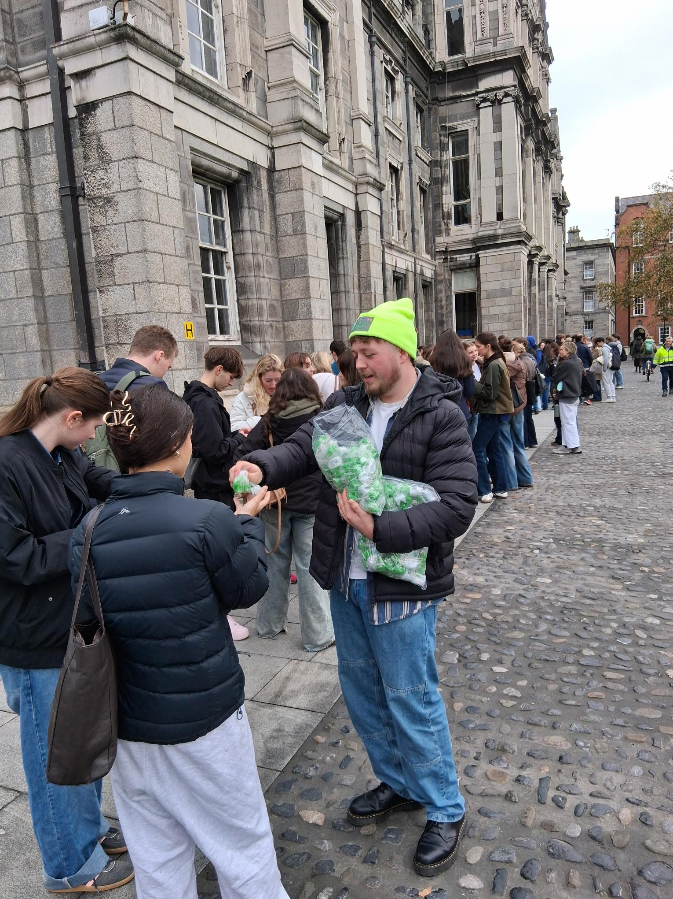
Active Campus
Getting to Campus – Download the TFI Live App or check our new map hub for how to get to and between all our campuses by foot, bike, or public transport.
Student Leap Card- Get a 50% discount on public transport with a Young Adult or Student Leap Card
Bike Parking: Botany Bay, The Arches in College Green and a brand new secure unit at our St James campus.
Bike Share: shared bike schemes around: Dublin Bikes, Bleeper and Moby, who are offering a 65% student discount.
Get Involved: Join staff and students in The Smarter Travel Committee. Or take part in one of our smarter travel challenges: Walktober, Marchathon, Ready Set Cycle, or The Smarter Travel Student Awards
Claire Byrne, Sustainable Travel Office
CBYRNE21@tcd.ie
Trinity Transport Survey – in your inbox soon, please complete it to win lots of great prizes!
Notes:
Dedicated sustainable travel officer – Claire Byrne
Leading on the smarter travel work started by Healthy Trinity which resulted in Trinity being awarded the Gold Smarter Travel Award from the National Transport Authority for outstanding commitment to sustainable and active travel
We got funding from NTA for a Campus Travel Plan which Claire as been leading on completing – thanks to everyone who fed back during the consultation phase – just going for approval now
Claire has also been working hard to install secure bike parking at St James – under construction right now – got these photos this morning –it will accommodate 32 bikes of a wide variety – standard, cargo, e bikes etc. It will be fully automated access with staff / student card. It will have lighting and CCTV for optimal security.
and engaging with community through a range of means including the Light up your bike campaign – 1500 bike lights dispersed last week

Slide 14
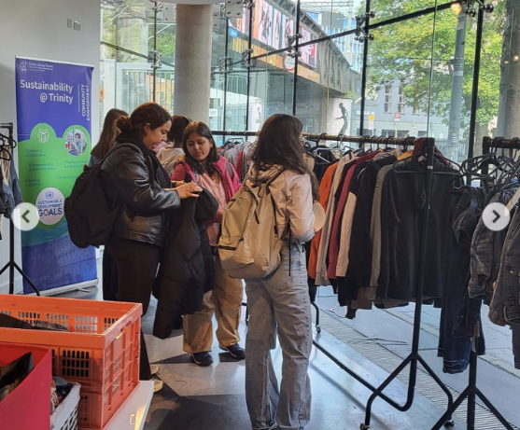
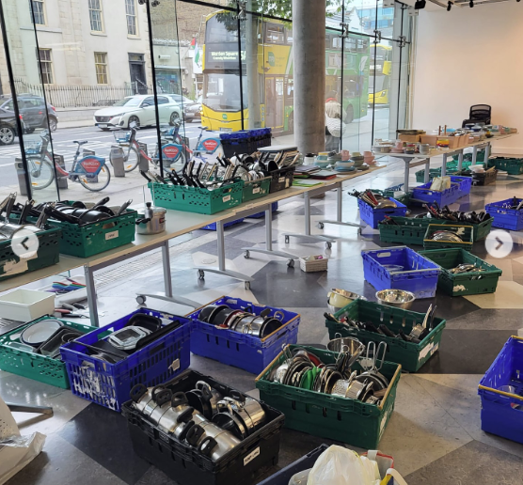
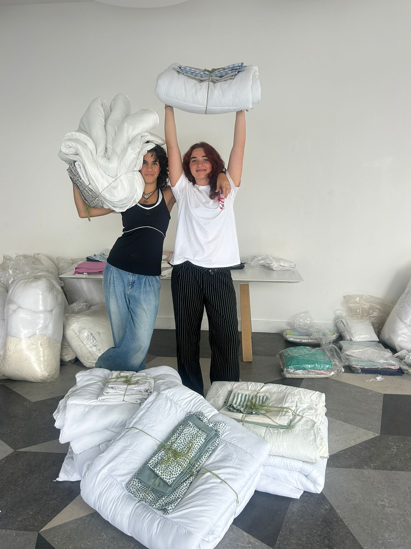
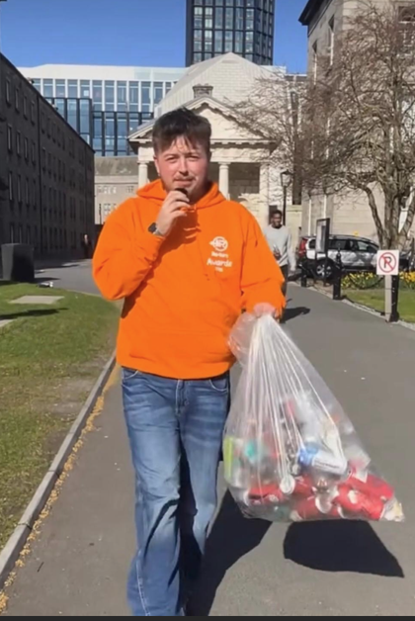
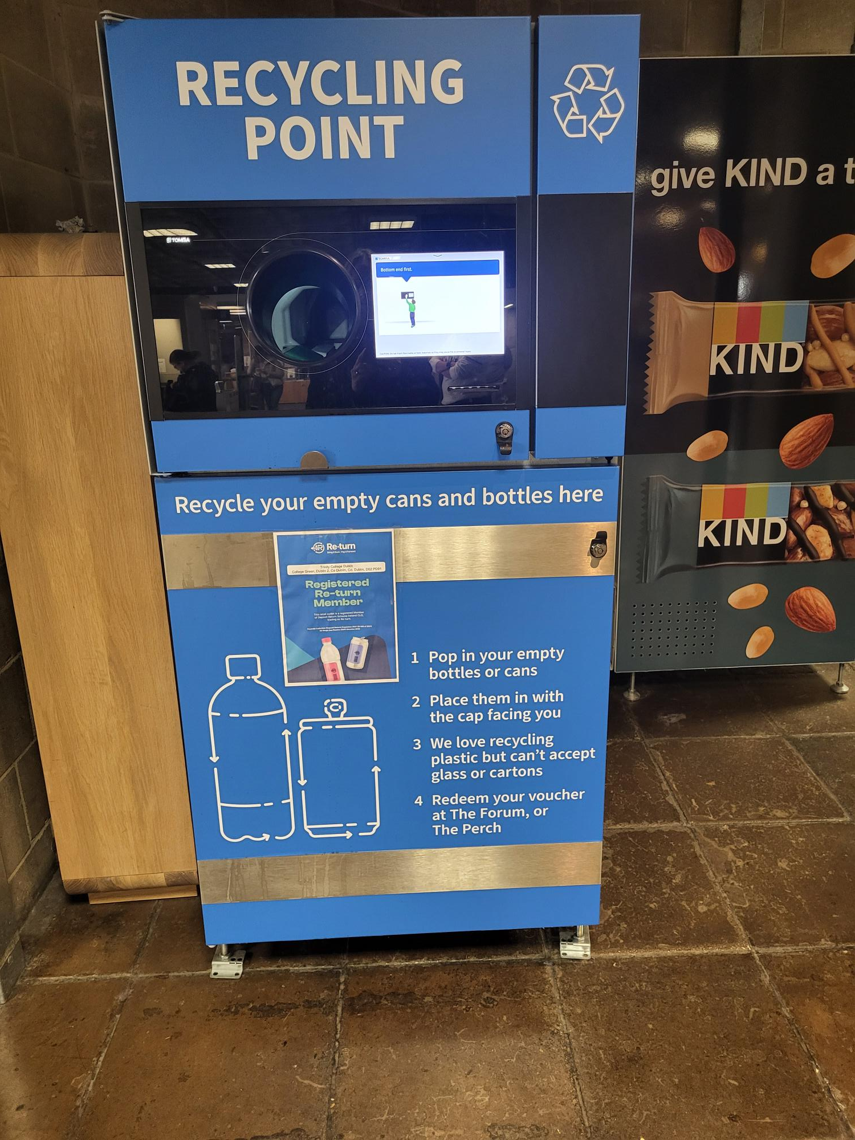
Circular campus
Trash 2 Treasure
Bedding Sale – Wednesday 9th September
Trash to Treasure Sale – Wednesday 16th & Thursday 17th September
Location: Former Science Gallery, Naughton Institute (just off Pearse Street)
Deposit Return Scheme – Student Ambassador
Notes:
Working to develop more circular campus – a waste action working group has been established to develop a circular campus plan
In the mean time, Trinity sustainability team worked with the students union – shout out to Amelia the SU environment officer who did a huge amount of work to deliver the extremely successful trash to treasure initiative. And this was to try and tackle this- the photo on the left – this is the waste generated when students move out of accommodation at the end of the academic year. Collected items in May, sorted, cleaned and stored over the summer and resold to new students in September,
Extremely successful this year – bedding bundles sold out in an hour – and Harry calculated the carbon savings - >6000kg co2 equivalents saved – about 12 thousand cappuccinos or the amount of electricity to power a house for a year…
And the sale of kitchen stuff, homeware, clothes etc was brilliant – huge demand from students, every item sold – important way not only to be circular, but to address cost of living crisis as well
T2T bedding sale=>
6061 kg CO2 eq.
Equivalent to
~12,000 Cappuccinos
~25,000 km in a car
~3 days of electricity for entire Trinity campus, or one home for a year
4025 kg CO2 estimated from rest of T2T but don’t have full inventory of what was collected and sold.
Waste action working group developing waste plan

Slide 15
How can you get involved?
Trinity College Dublin, The University of Dublin

Slide 16




Trinity has applied to gain Observer Status for COP16 for the Convention for Biological Diversity
Trinity has gained Observer Status for COP28 & 29 for the Climate Change Conference
Trinity has achieved four Green Flags since 2013.
Trinity is a signatory to the new Nature Positive Universities network
Taking Action and Making Commitments

Slide 17
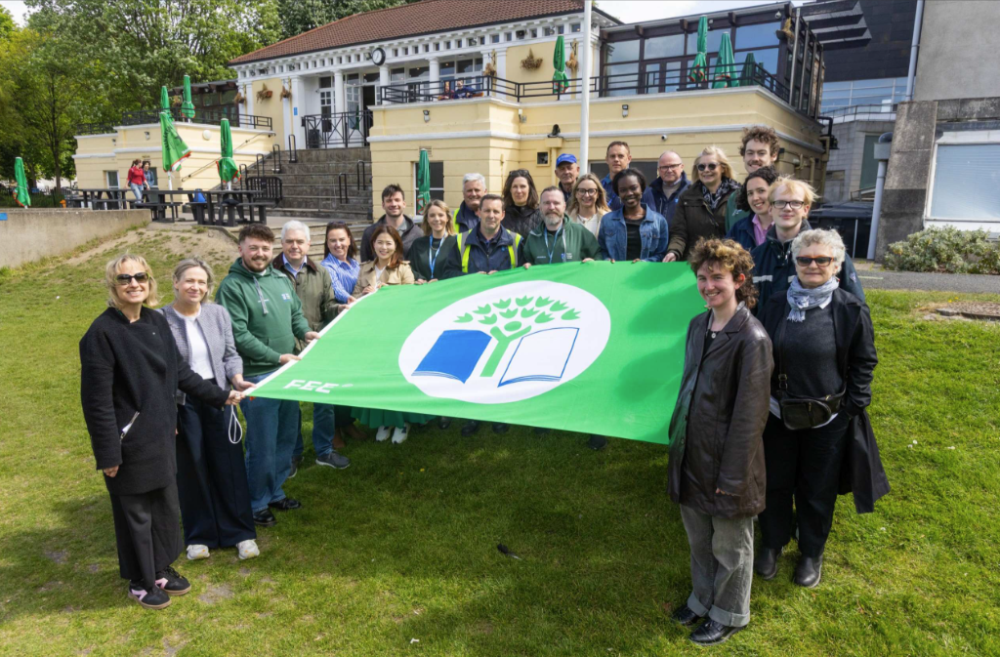
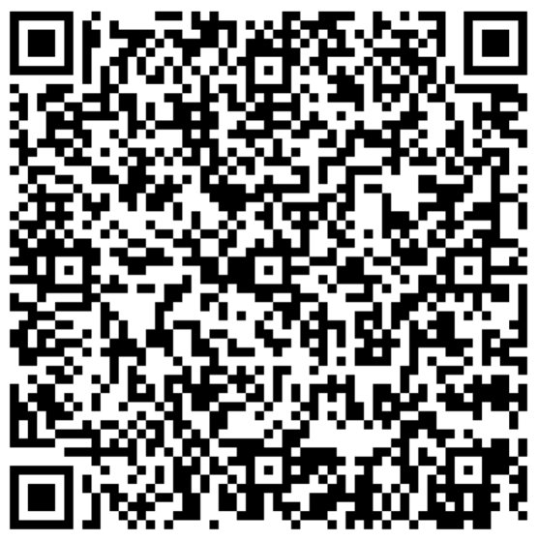
Join the Green Campus Committee
Email sustainability@tcd.ie

Slide 18

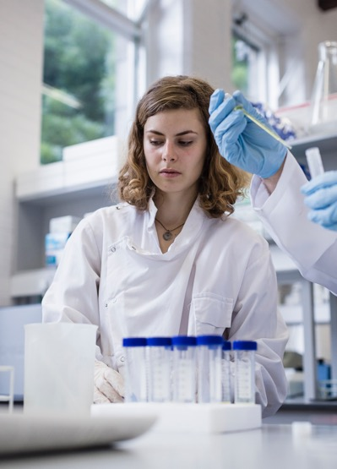
Join the TCD Green Labs committee
Email: greenlabs@tcd.ie

Slide 19
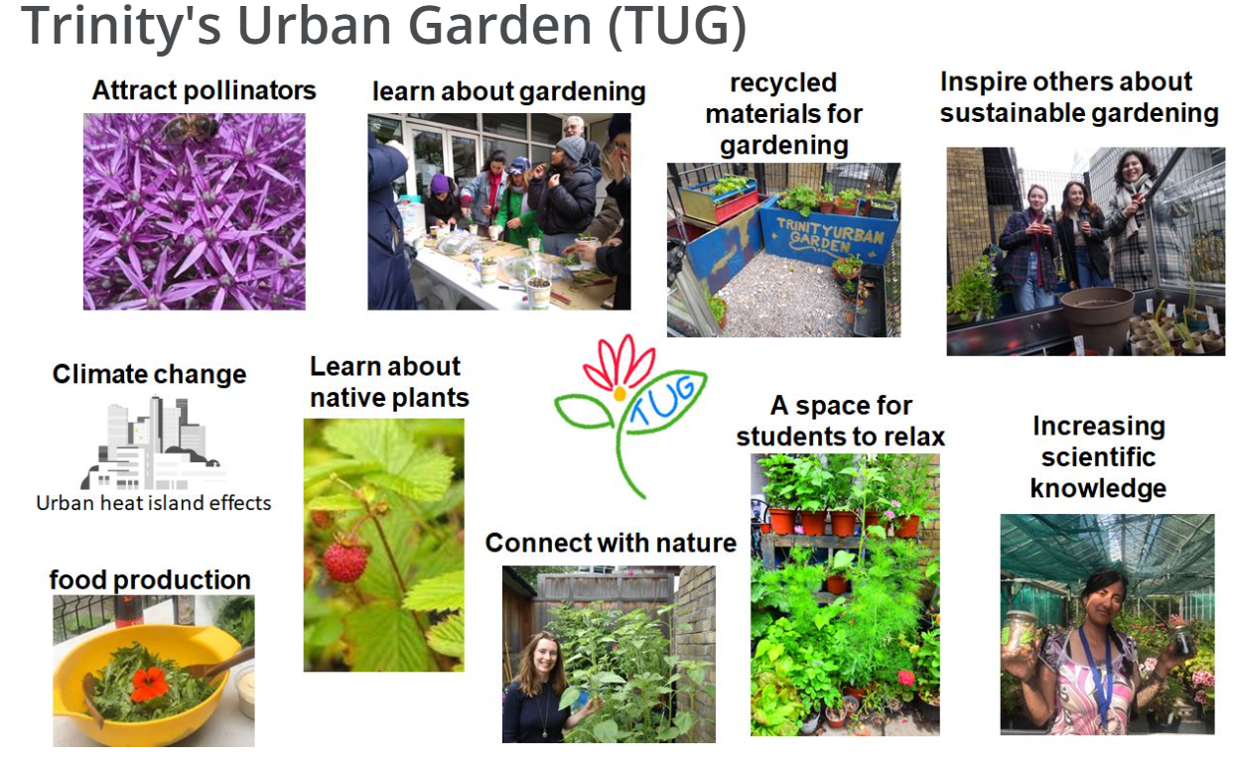
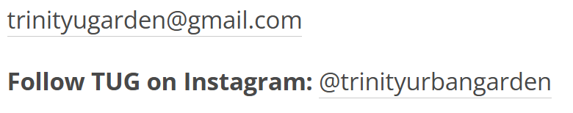

Slide 20

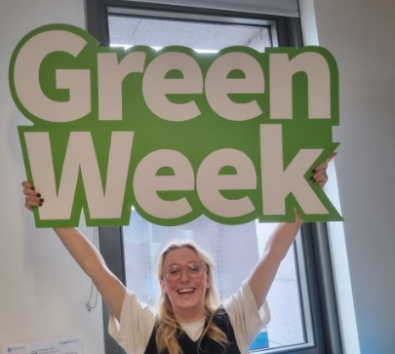
October
March
Save the date - Get Involved!

Slide 21
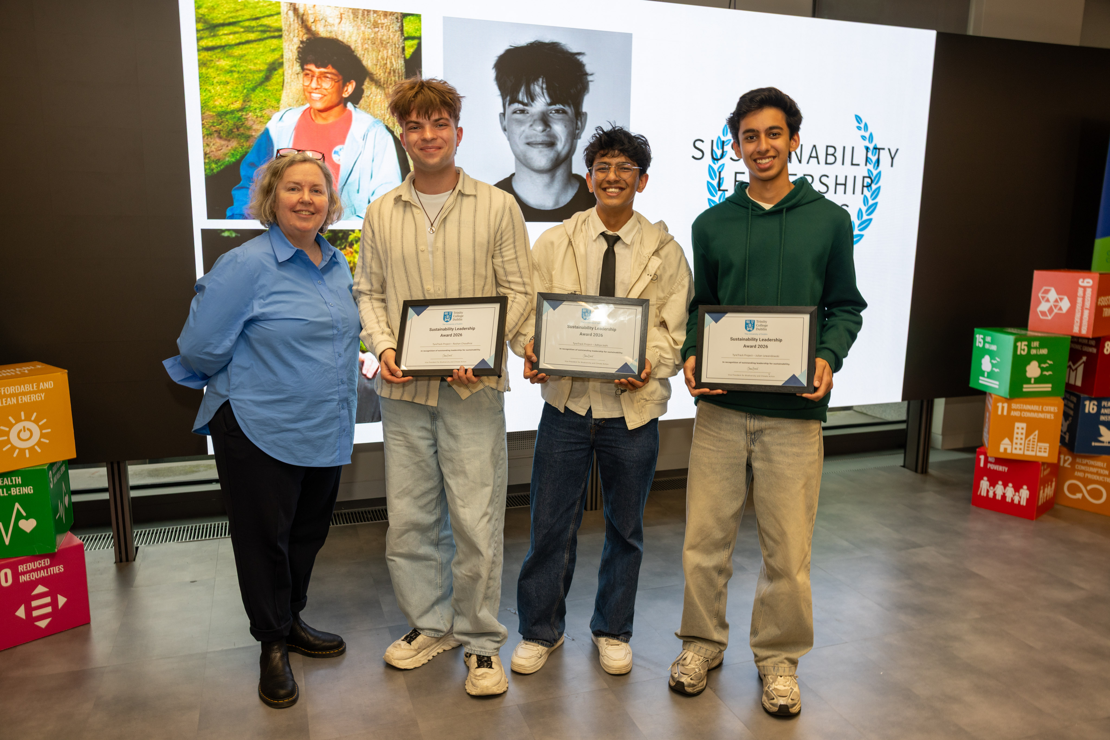
Sustainability Leadership Awards
Nominate yourself or a friend in February

Slide 22
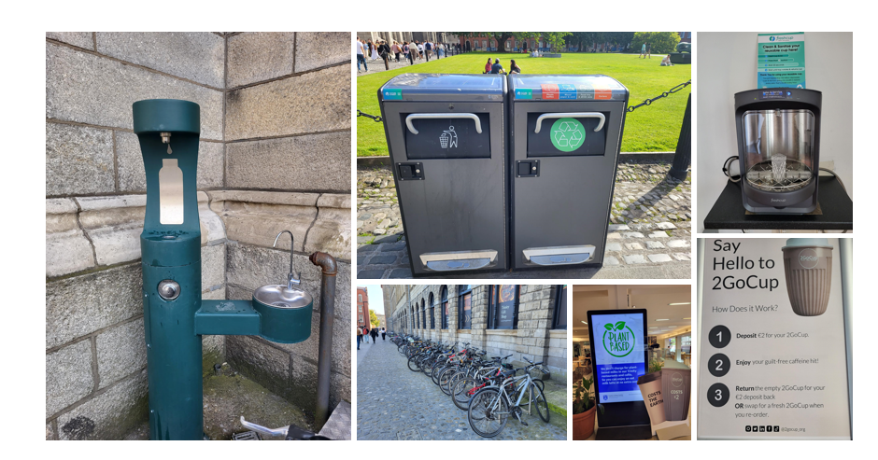
- use less
- share resources
- use sustainable transport
- ditch the disposables
- plant slant your meals
- reuse, repair, recycle
- switch off,
- get involved and speak up!
Everyday sustainable behaviours start with the basics…

Slide 23
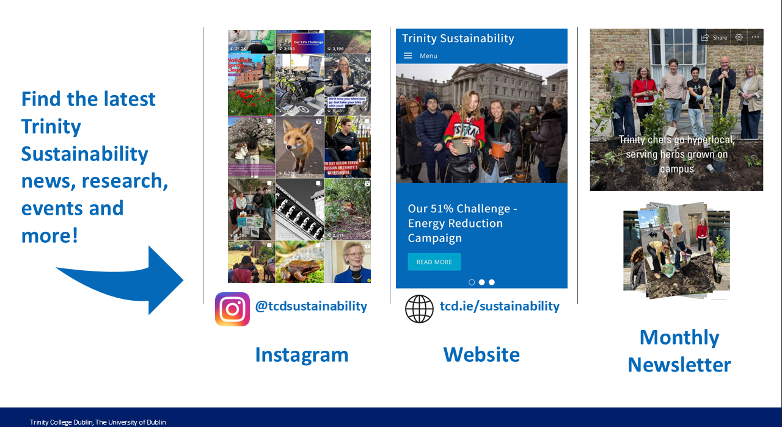


Slide 24
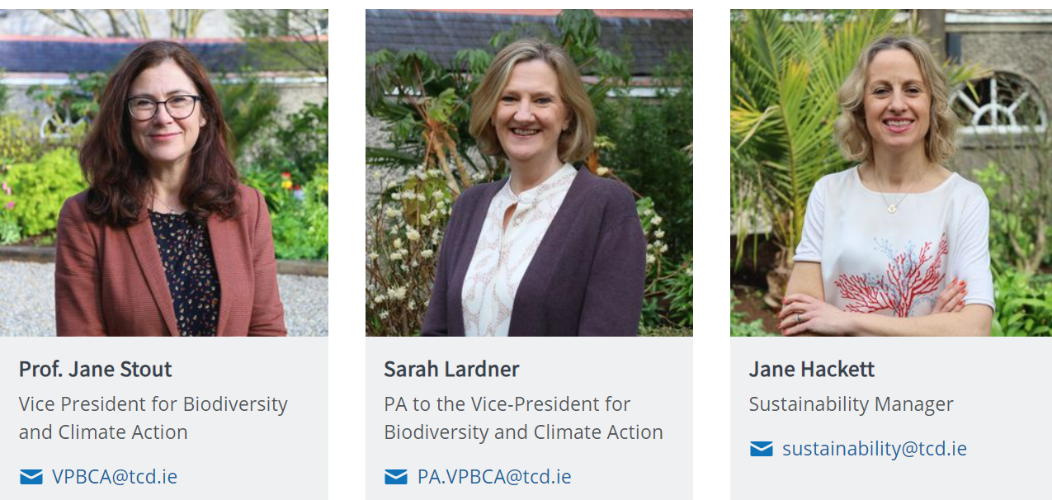
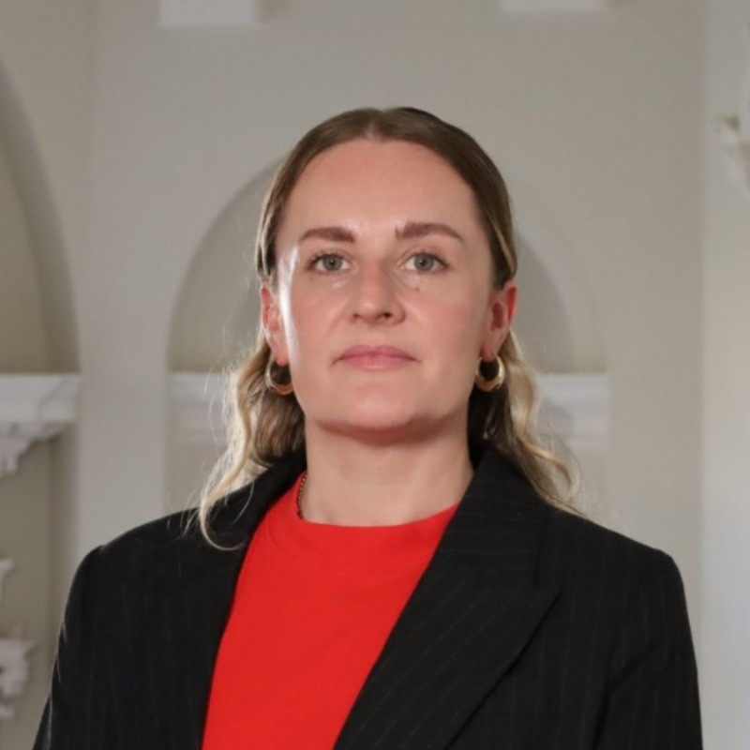
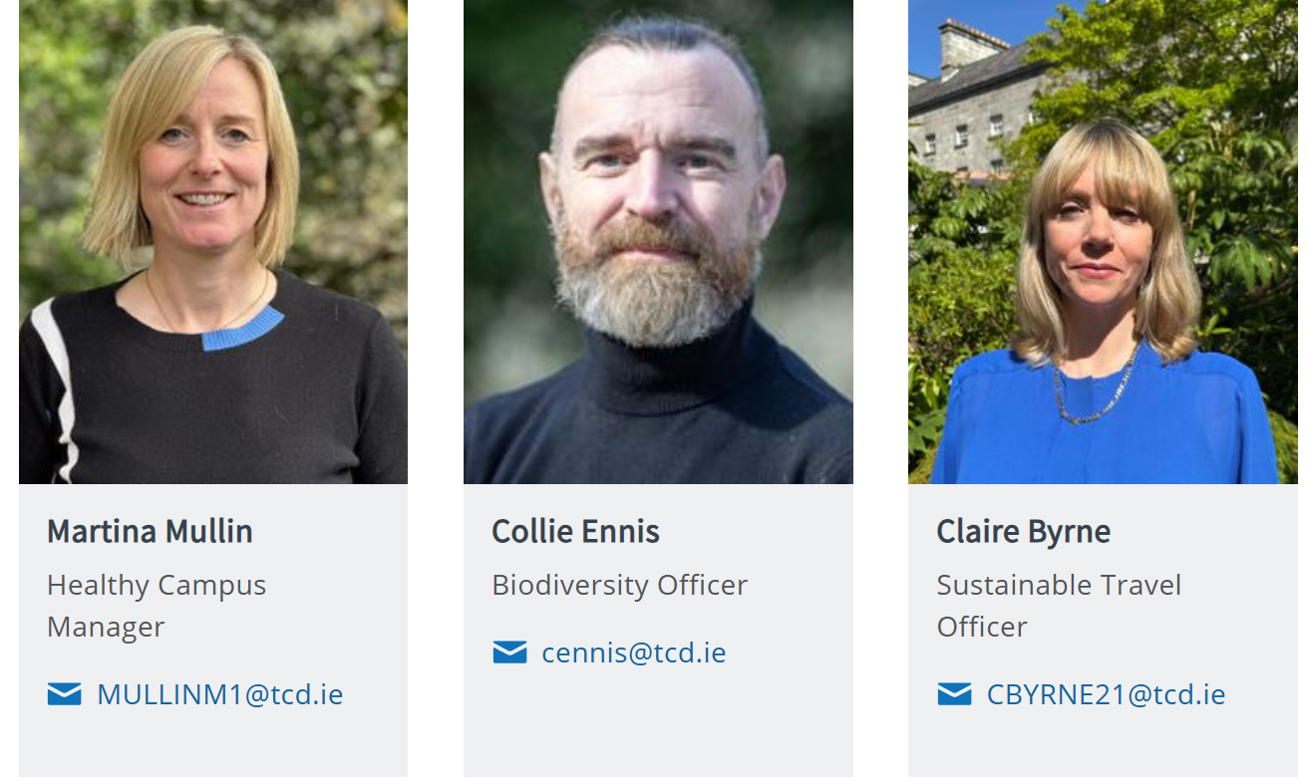
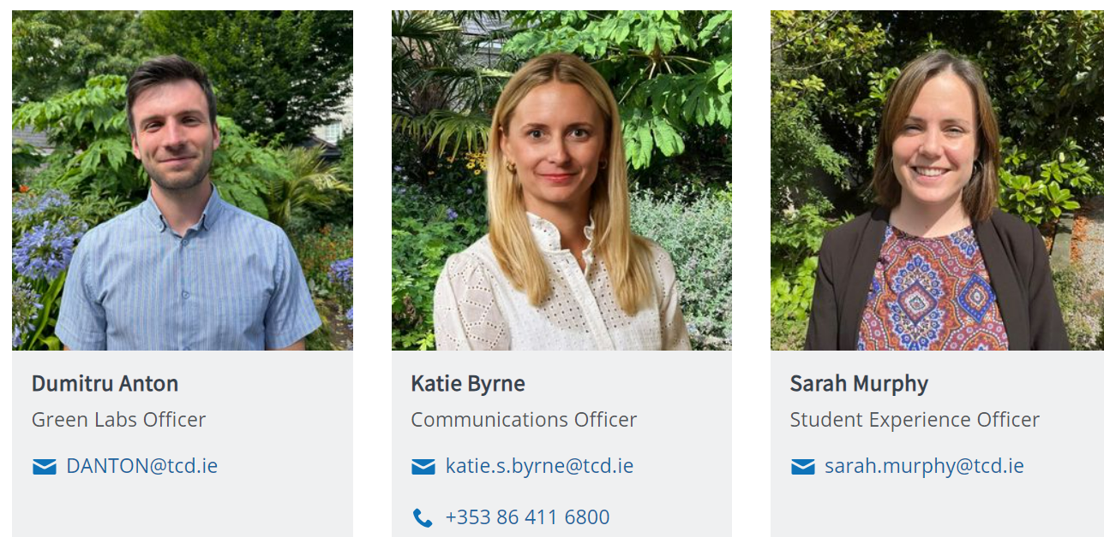
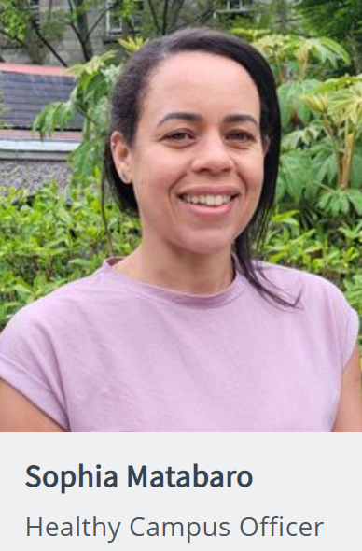
Trinity Sustainability
Laetitia Deering

